Slide 1
Zomato Order & Restaurant Analysis Using Power BI

Slide 2
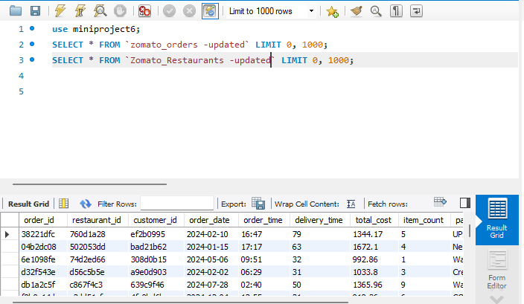
Task 1: Upload Dataset into MySQL

Slide 3
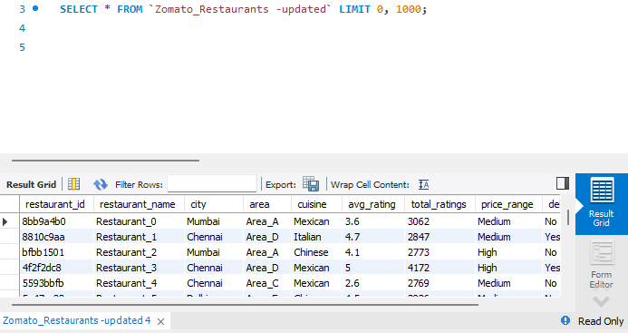
Cont.,

Slide 4
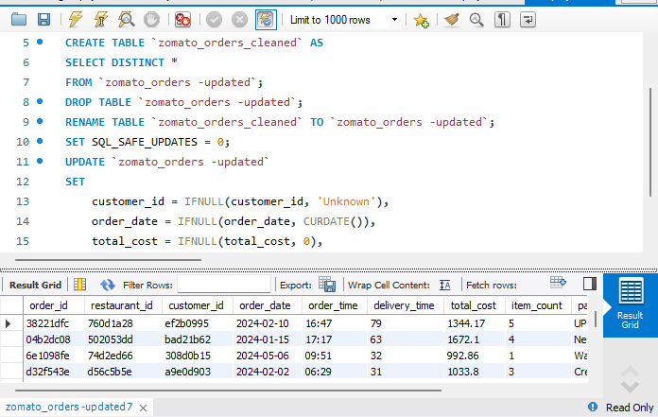
Task 2: Perform Simple Data Transformations Using SQL

Slide 5
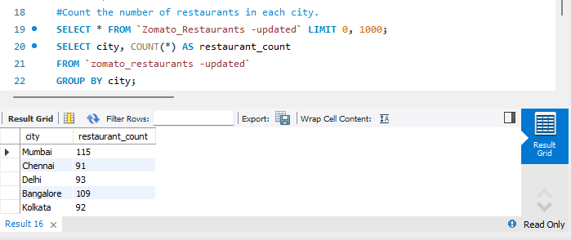
Data Exploration Queries

Slide 6
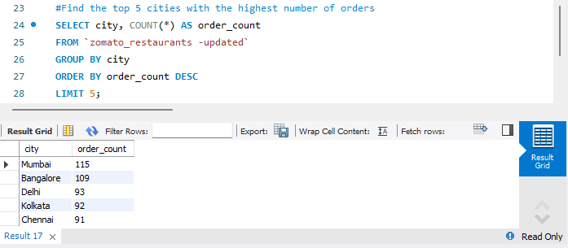
Cont.,

Slide 7
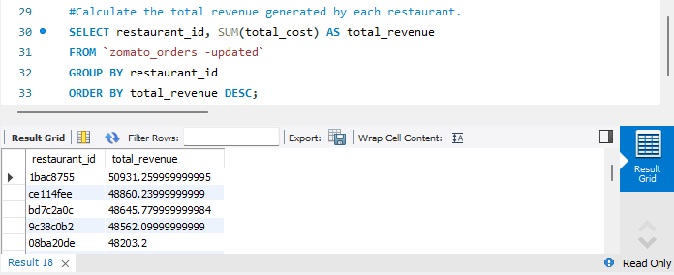
Cont.,

Slide 8
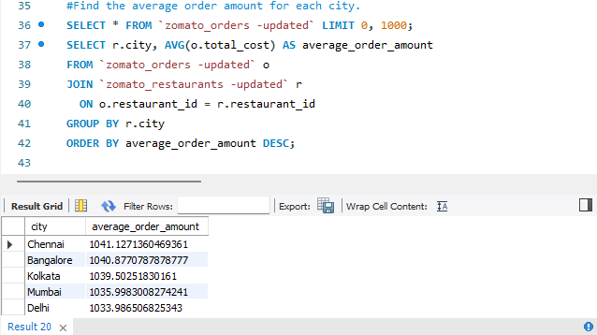
Data Aggregation

Slide 9
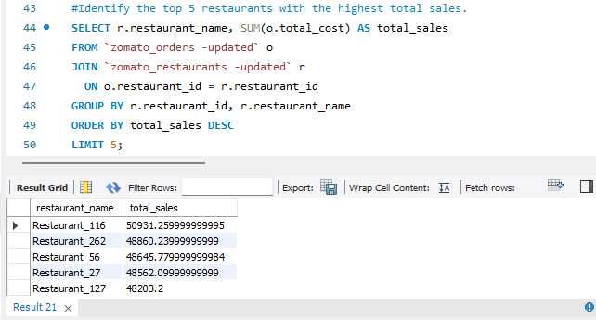
Identify the top 5 restaurants with the highest total sales.

Slide 10
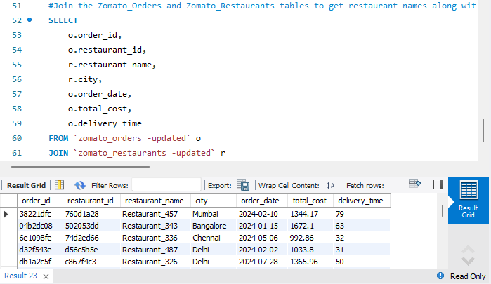
Join the Zomato_Orders and Zomato_Restaurants tables to get restaurant names along with order details.

Slide 11
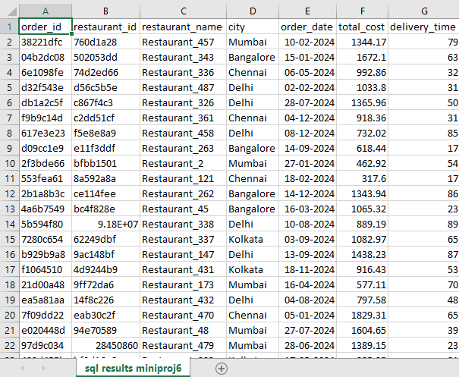
Save the transformed data as an Excel file.

Slide 12
Task 3: Power BI Analysis and Visualization

Slide 13
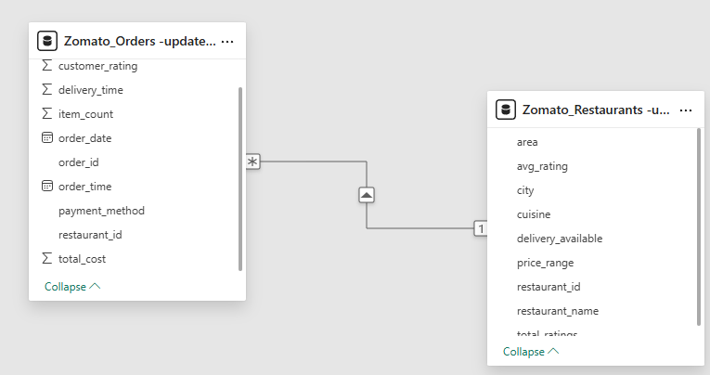
Establish a relationship between Restaurant_ID in both datasets

Slide 14
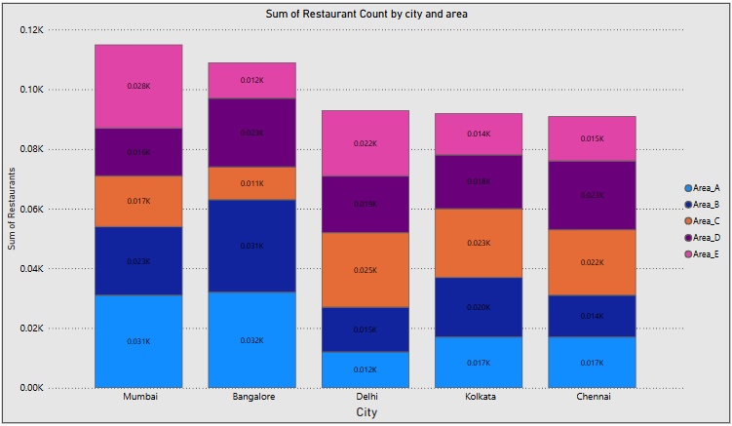
Task 1: Number of Restaurants per City

Slide 15
Insights of Task-1
Mumbai
Fairly balanced distribution across areas.
Area_A and Area_B are the largest contributors (~0.031K and ~0.023K respectively).
Area_E has a decent share as well.
Bangalore
Area_A is the dominant contributor (~0.032K).
Area_D also has a significant share (~0.023K).
Area_C has a smaller presence compared to other areas.
Delhi
Area_C stands out as the largest contributor (~0.025K).
Area_E also shows strong representation.
Area_A is the smallest segment.
Kolkata
Area_C and Area_D dominate, with Area_C slightly ahead.
Area_A has a smaller presence.
Chennai
Area_D and Area_C contribute the most (~0.023K and ~0.022K).
Area_B has a smaller share (~0.014K).

Slide 16
Cont.,
Mumbai and Bangalore have the highest restaurant counts.
Area_A is dominant in Mumbai and Bangalore.
Area_C and Area_D are strong across Delhi, Kolkata, and Chennai.
Delhi has a high concentration in Area_C.
Kolkata and Chennai show similar patterns with Area_C and Area_D leading.
Area_E has lower presence overall except in Mumbai and Delhi.
Distribution suggests Mumbai is more balanced, while other cities have key dominant areas.

Slide 17
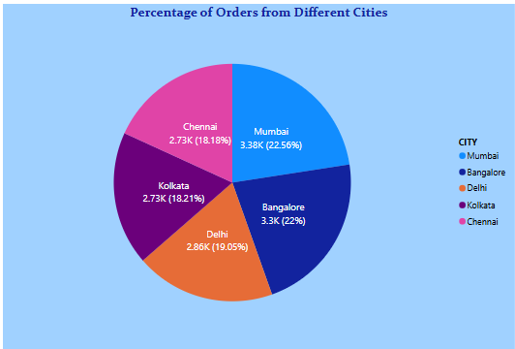
Task 2: Percentage of Orders from Different Cities

Slide 18
Insights of Task-2
Mumbai (22.56%) & Bangalore (22%) lead in orders.
Delhi (19.05%), Kolkata (18.21%), Chennai (18.18%) follow closely.
Narrow gap between Mumbai (22.56%) and Bangalore (22%) highlights a tight race for the top spot in order volume.
Balanced demand across all 5 cities.
Focus areas: Boost efforts in Mumbai/Bangalore; while maintaining engagement in other cities to capitalize on their steady contributions.

Slide 19
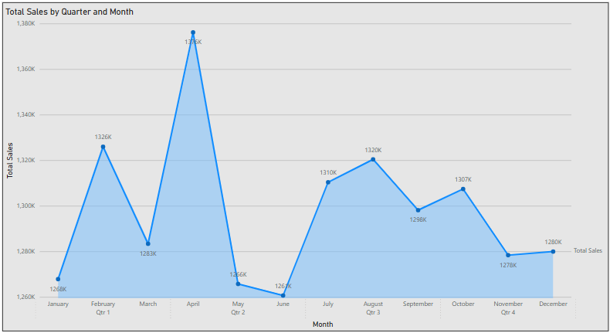
Task 3: Order Amount Trends Over Time

Slide 20
Insights for Task-3
Peak Sales: April recorded the highest sales at 1376K, showing a significant spike.
Lowest Sales: June had the lowest sales at 1261K, indicating a sharp dip.
Q1 Performance: Moderate growth with a peak in February (1326K) followed by a slight drop in March.
Q2 Fluctuation: Drastic increase in April, then a steep decline through May and June.
Q3 Stability: More stable with slight variations; highest in August (1320K) and lowest in September (1298K).
Q4 Decline: Downward trend from October (1307K) to November (1278K), with a slight recovery in December (1280K).
Seasonal Impact: Q2 shows high volatility, possibly due to seasonal factors or promotions.

Slide 21
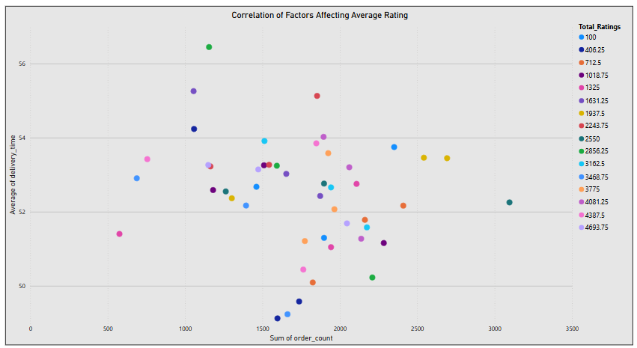
Task 4: Correlation of Factors Affecting Average Rating

Slide 22
Insights of Task-4
No Strong Linear Correlation: There’s no clear linear trend between order count and average delivery time.
High Order ≠ High Delivery Time: Some high order counts (>3000) have moderate delivery times (~52), indicating good operational efficiency.
Delivery Time Spread: Most delivery times cluster between 50 to 54 minutes, regardless of order count.
Rating Distribution: Color gradient shows Total Ratings—they are spread across all combinations, with no clear dominance in any one region.
Efficiency Outliers: A few data points have low delivery time with high order count, signaling best-performing units.

Slide 23
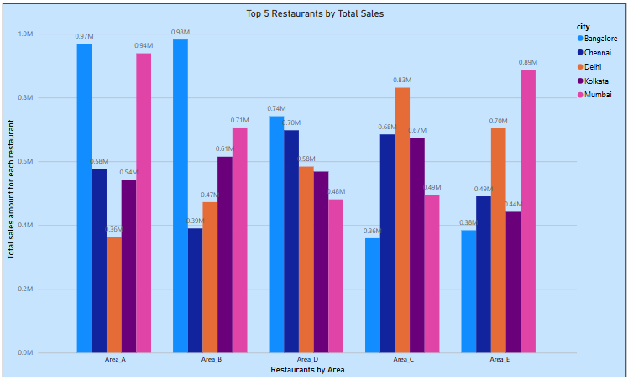
Task 5: Top 5 Restaurants by Total Sales

Slide 24
Insights of Task-5
Bangalore Leads Overall: Consistently high sales across areas, peaking in Area B (0.98M) and Area A (0.97M).
Mumbai’s Strong Show: Mumbai shows high performance in Area A (0.94M) and Area E (0.89M).
Delhi’s Peak: Delhi tops in Area C (0.83M), leading among cities in that area.
Chennai’s Consistency: Moderate sales across all areas; strongest in Area E (0.70M).
Kolkata Trails: Generally lower sales, with highest in Area C (0.67M).

Slide 25
Cont.,
Area B slightly edges out Area A for the top spot, thanks to Bangalore’s standout performance (0.98M).
Mumbai shows strong performance in multiple areas, contributing heavily to Area A, B, and E.
Delhi dominates Area C, helping it secure the 3rd position.
All top 5 restaurants are competitive, with total sales above 3M each.

Slide 26
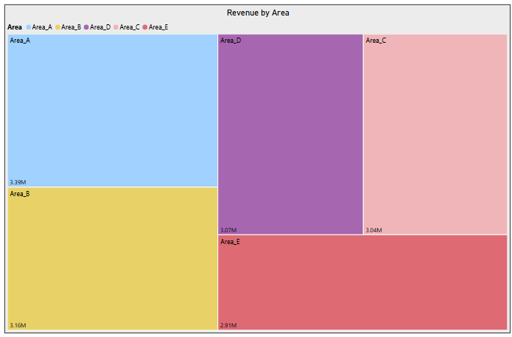
Task 6: Revenue by Area Using a Tree Map

Slide 27
Insights from Task-6
High-Revenue Areas:
  Area A – 3.39M (Highest revenue generator)
  Area B – 3.16MArea D – 3.07M
Low-Revenue Areas:
  Area E – 2.91M (Lowest revenue)
  Area C – 3.04M
Key Insight:
  Area A is the top-performing area.
  Revenue across all areas is relatively close, but Area E lags slightly, suggesting potential for improvement or investment focus.

Slide 28
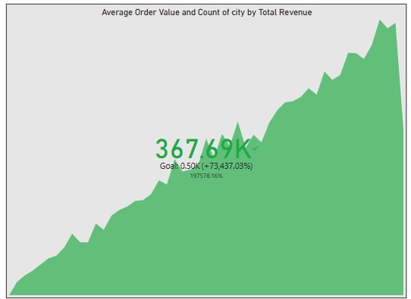
Task-8: KPI Cards – Total Revenue & Average Order Value

Slide 29
Insights for Task-8
💰 Current KPI Value:367.69K – This represents the Average Order Value aggregated over city-wise total revenue.
🎯 Goal:0.50K – The initial target benchmark.
🚀 Performance: Surpassed the goal by +73,437.03%, indicating massive overachievement.
📈 Trend: Steady and consistent upward growth over time, reflecting strong performance in both order value and revenue generation.

Slide 30
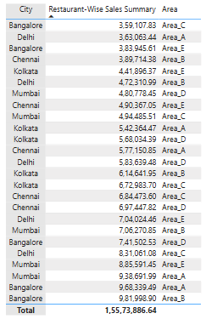
Task 9: Restaurant-Wise Sales Summary in a Table

Slide 31
Insights for Task-9
Top Performers:
  Bangalore (Area_B) and Mumbai (Area_A) have the highest individual sales (~₹9.8L & ~₹9.4L).
  Kolkata dominates mid-range sales (₹4.4L–₹6.7L).
City Trends:
  Mumbai leads in total high-value sales (multiple entries above ₹7L).
  Chennai and Delhi show consistent performance across areas.
Area Analysis:
  Area_E (Kolkata, Delhi, Mumbai) and Area_A (Mumbai, Bangalore) are top revenue generators.
Total Sales: ₹1.56 crore, with contributions spread across cities and areas.
Summary: Mumbai and Bangalore drive premium sales, while Kolkata and Chennai show balanced performance. Areas E and A are key revenue hubs.

Slide 32
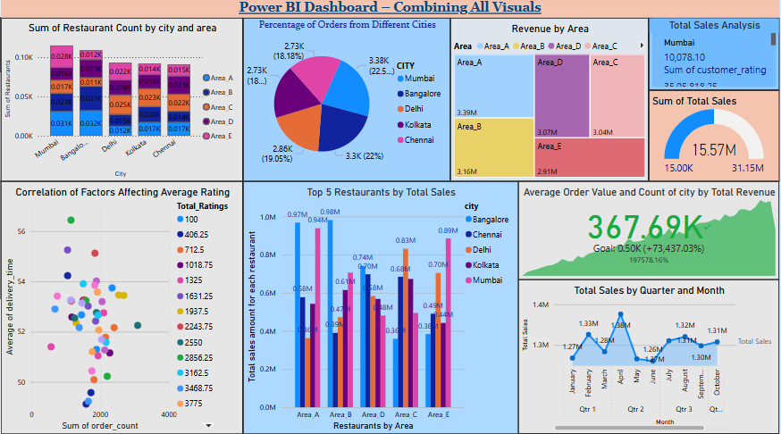
Task 10: Power BI Dashboard – Combining All Visuals

Slide 33
Insights for Task-10
Restaurant Count by City & Area: Mumbai leads in restaurant count, followed by Bangalore and Delhi.
Order Percentage by City: Delhi (22.5%) and Chennai (22%) have the highest share of orders.
Revenue by Area: Area_B generates the maximum revenue (~3.9M), ahead of other areas.
Total Sales Analysis: Mumbai has 10,078 customer ratings and leads in sales (~35M).
Sum of Total Sales: Total sales across all cities stand at 15.57M.
Correlation Analysis: Higher order counts correlate with better average delivery times and ratings.
Top 5 Restaurants by Sales: Area_B restaurants show the strongest sales performance across cities.
Average Order Value & Count: Achieved 367.69K, surpassing the 50K goal by a huge margin (+73,437.03%).
Sales by Quarter & Month: Q2 shows the highest sales peak (~1.58M), indicating strong mid-year performance.

Slide 34
Results
A well-structured dashboard showcasing key performance metrics.
Identification of high-revenue restaurants and customer ordering patterns.
Location-based analysis of demand and restaurant density.
Improved understanding of delivery time efficiency.

